Slide 1
Multi-variate Linear Regression 2
Deep-Learning Seminar ch.10

Slide 2
Contents
For One Sample - Implementation for n Features
For One Sample - Implementation of Affine Function

Slide 3
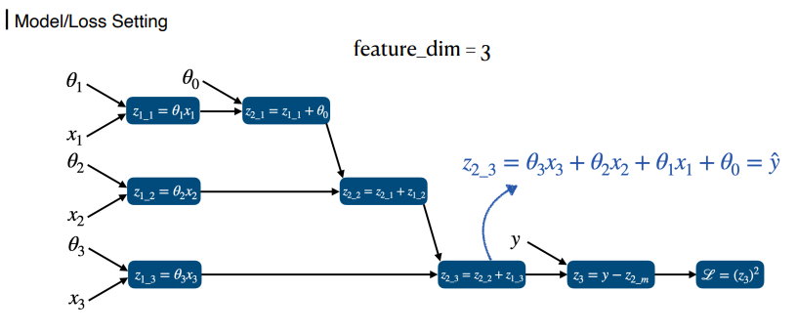
For One Sample - Implementation for n Features
Deep-Learning Seminar ch.10

Slide 4
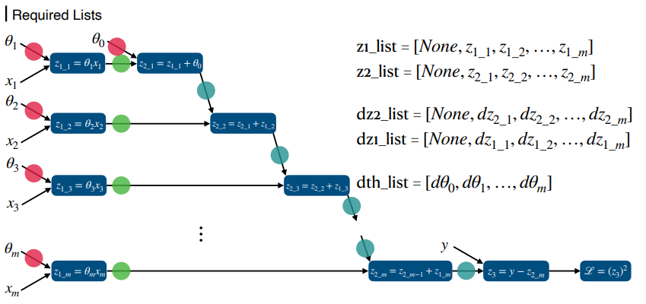
For One Sample - Implementation for n Features
Deep-Learning Seminar ch.10

Slide 5
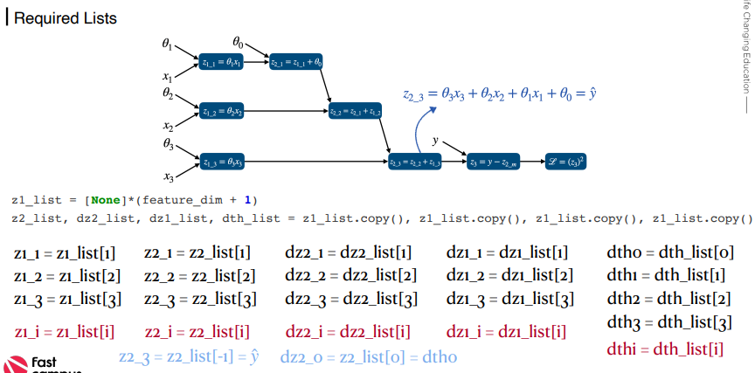
For One Sample - Implementation for n Features
Deep-Learning Seminar ch.10

Slide 6
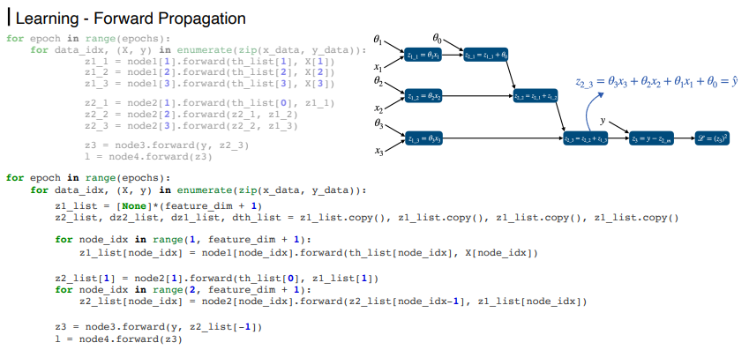
For One Sample - Implementation for n Features
Deep-Learning Seminar ch.10

Slide 7
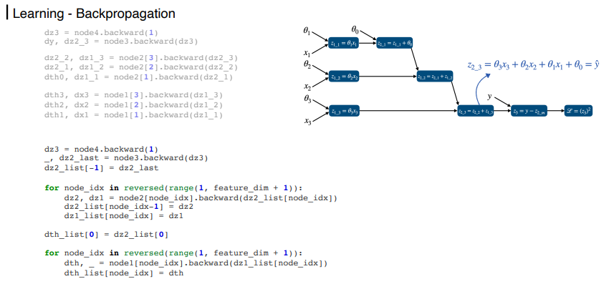
For One Sample - Implementation for n Features
Deep-Learning Seminar ch.10

Slide 8
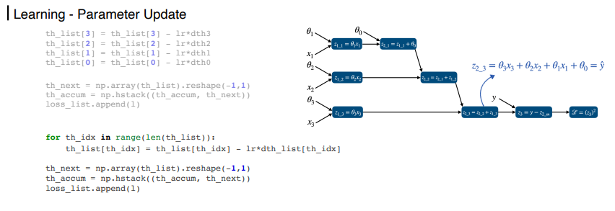
For One Sample - Implementation for n Features
Deep-Learning Seminar ch.10

Slide 9
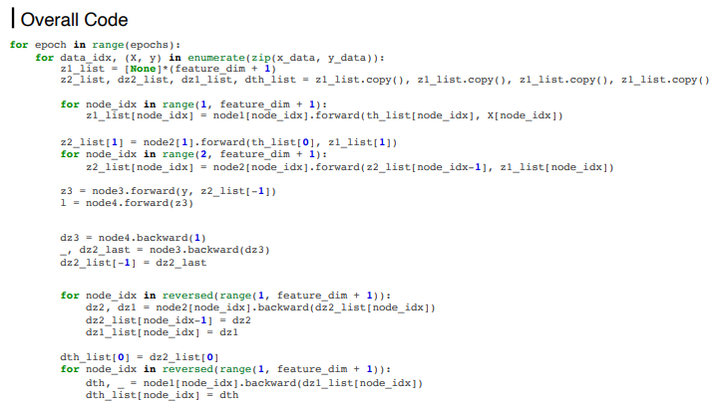
For One Sample - Implementation for n Features
Deep-Learning Seminar ch.10

Slide 10
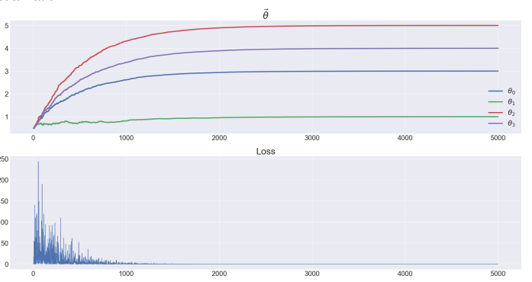
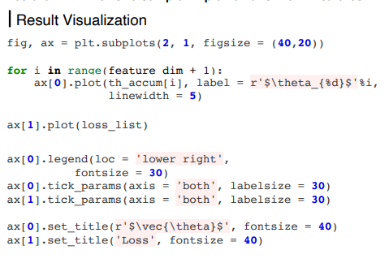
For One Sample - Implementation for n Features
Deep-Learning Seminar ch.10

Slide 11
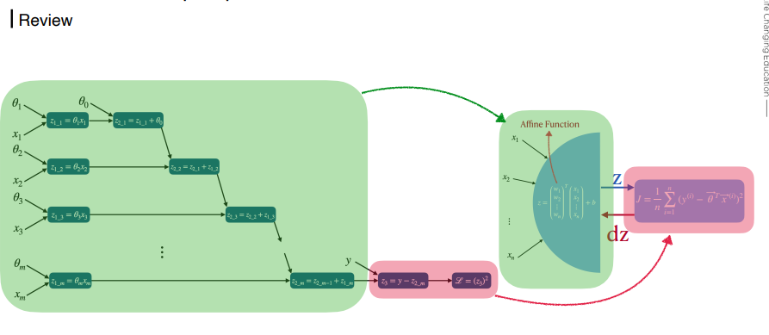
For One Sample - Implementation of Affine Function Seminar ch.10

Slide 12
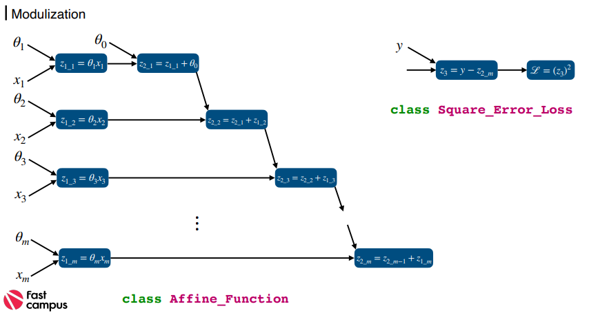
For One Sample - Implementation of Affine Function Seminar ch.10

Slide 13
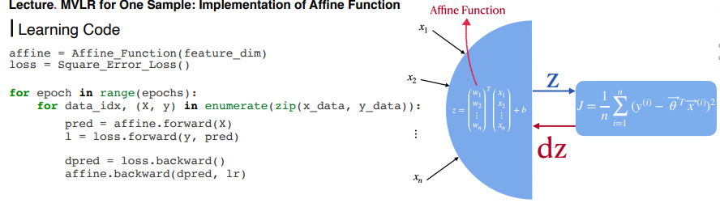
For One Sample - Implementation of Affine Function Seminar ch.10

Slide 14
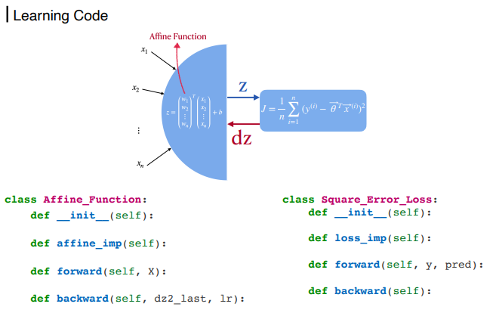
For One Sample - Implementation of Affine Function Seminar ch.10

Slide 15
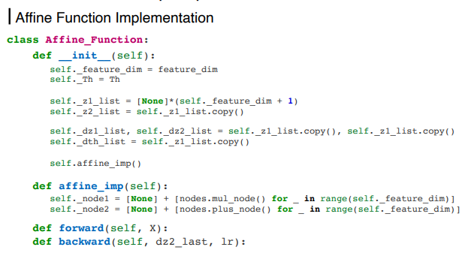
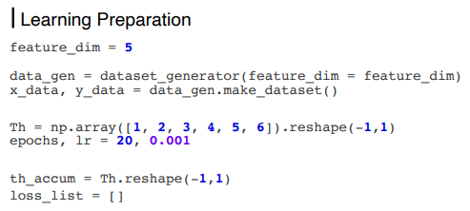
For One Sample - Implementation of Affine Function Seminar ch.10

Slide 16
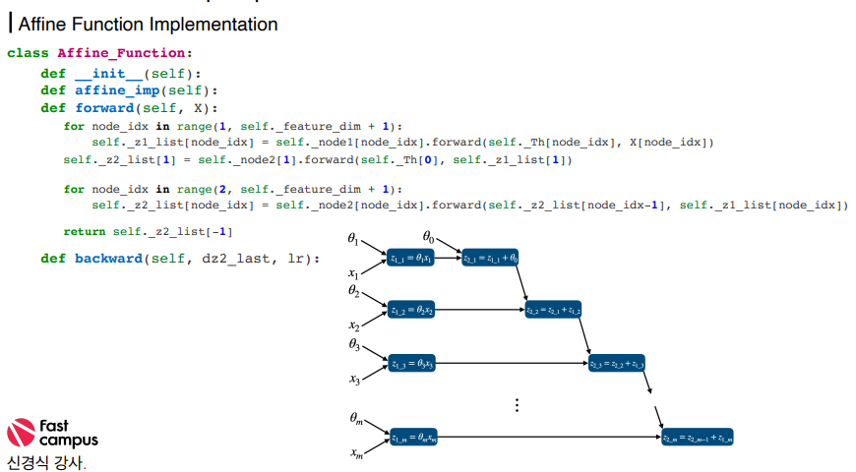
For One Sample - Implementation of Affine Function Seminar ch.10

Slide 17
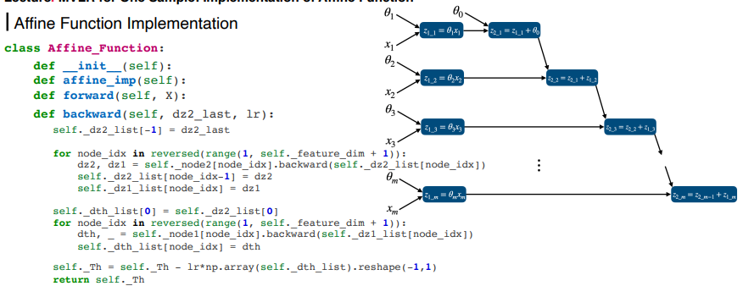
For One Sample - Implementation of Affine Function Seminar ch.10

Slide 18
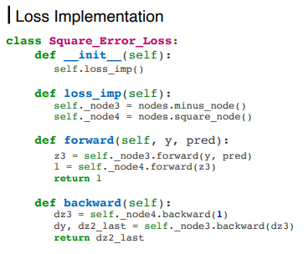
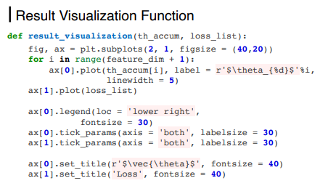
For One Sample - Implementation of Affine Function Seminar ch.10

Slide 19
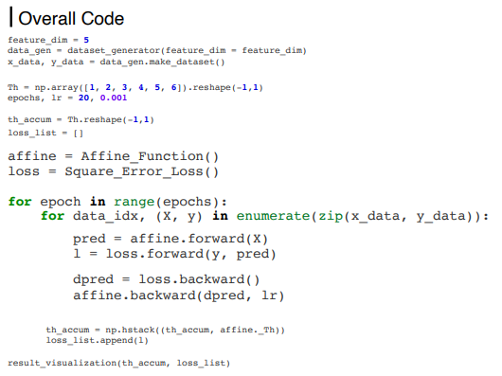
For One Sample - Implementation of Affine Function Seminar ch.10

Slide 20
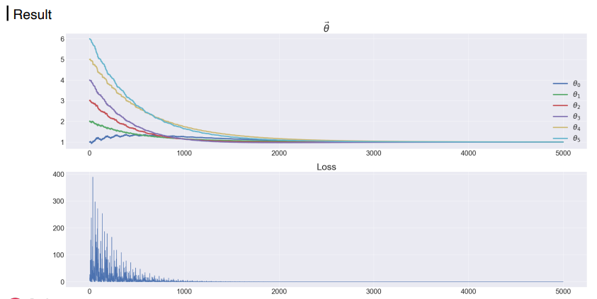
For One Sample - Implementation of Affine Function Seminar ch.10

Slide 21
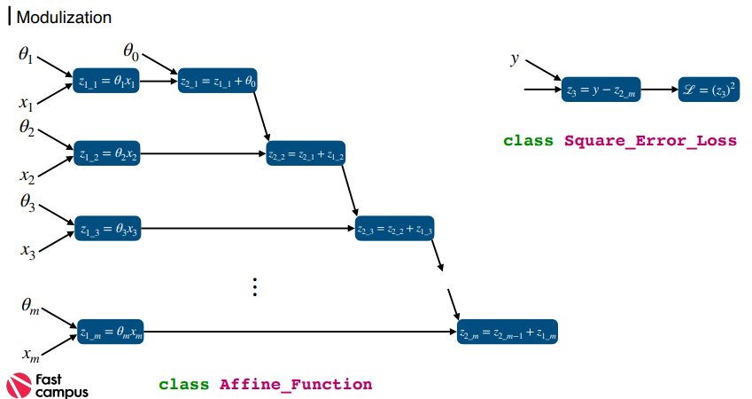
For One Sample - Implementation of Affine Function Seminar ch.10

Slide 22
감사합니다.

